Slide 1
MODERN TRENDS IN
INDIAN BANKING SECTOR
BY
DR. D. ILANGOVAN, M.COM., PH.D.
PROFESSOR, DEPARTMENT OF COMMERCE,
ANNAMALAI UNIVERSITY, ANNAMALAINAGAR-608 002
MOB: 09443738926 Email: DIL2691@YAHOO.CO.IN
ANNAMALAI UNIVERSITY
DEPARTMENT OF COMMERCE
WELCOME PARTICIPANTS

Slide 2
WELCOME PARTICIPANTS
TO THEME PRESENTATION
FOLLOWED BY GROUP DISCUSSION

Slide 3
INDIAN BANKING IN THE PAST
CLASS BANKING
LIMITED AND SELECTED SERVICES
VERY FEW BRANCHES
RARE VOLUNTARY SERVICES LIKE NYC
NO INTERNATIONAL CONTACTS AND SERVICES
SECTORAL IMBALANCE BETWEEN INDUSTRY AND AGRICULTURE
RESTRICTED USE OF CREDIT INSTRUMENTS

Slide 4
REASONS BEHIND INNOVATIVE TRENDS
RAPID INDUSTRIALISATION
INCREASED INTERNATIONAL TRADE
MODERNISATION OF AGRICULTURE
INTRODUCTION OF NEW ECONOMIC POLICY
BANKING SECTOR REFORMS
FINANCIAL SECTOR REFORMS
GLOBALISATION, LIBERALISATION, PRIVATISATION
GROWING ECONOMY

Slide 5
BORDERLESS BANKING
SERVICES WITHIN THE NATION AND OVERSEAS
E-BANKING
ONLINE BANKING
TELE-BANKING
NET BANKING
MOBILE BANKING FOR CRM
MECHANICAL TRANSACTIONS [THROUGH ATM]
PLASTIC CARDS [DEBIT CARDS, CREDIT CARDS and SMART CARDS]

Slide 6
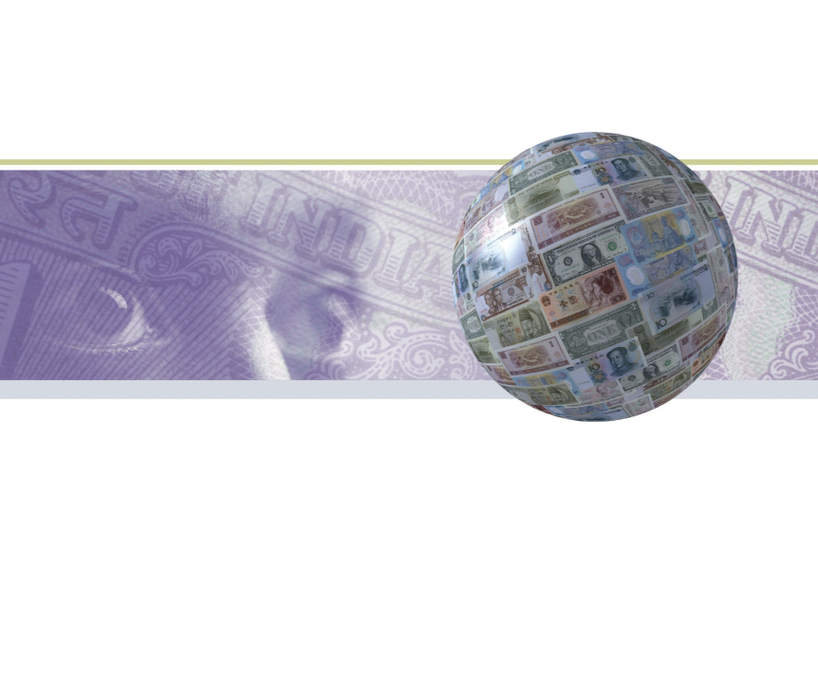
BANKING BEYOND BANKING
ADVANCED TECHNOLOGY FOR VALUE CREATION
RETAIL BANKING FOR RURAL CUSTOMERS
BREAK THROUGH IN THE BUSINESS OF LENDING
DOWN TO EARTH APPROACH IN DEPOSITS
MASS BANKING FOR MORE PRODUCTIVITY

Slide 7
Total automated teller machines
Bank Group | No. of Branches | On Site ATM | Off Site ATM | Total ATM
Nationalized Banks | 33,627 | 3,205 | 1,567 | 4,772
State Bank of India | 13,661 | 1,548 | 3,672 | 5,220
Old Private Sector Banks | 4,511 | 800 | 441 | 1,241
New Private Sector Banks | 1,685 | 1,883 | 3,729 | 5,612
Foreign Banks | 242 | 248 | 579 | 79

Slide 8
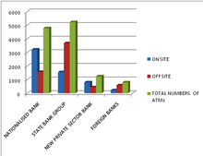
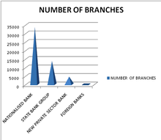
Total no. of atm vs. total no. of branches

Slide 9
debit cards
Debit cards are a mode of convenient payment technique. They allow the spenders to purchase what is in his account only. They don't increase or create loans. These are of two types:
Direct Debit Cards: They are used only for on-line transaction of money. They are also called point of sale. It is an immediate transfer of money from customer's account to seller's account.
Differed Debit Cards: They bear a visa or Master Card logo. They are used for off-line as well as online transactions.

Slide 10
Credit cards
Credit Cards are a mode of easy payment where the person pays by taking short term loans from banks by using his card. Credit cards charge interest and are primarily used for short-term financing.
Most of the stores allow payment of goods and services through credit cards. Because of their wide spread acceptance, credit cards are one of the most popular forms of payment for consumer goods and services in India.
The amount of interest charged depends on the bank from which credit card is taken.

Slide 11
Smart cards
They are like credit cards with implanted computer chips in them. The computer chip will store sensitive data and processes them. They are of three types:
Memory card
Intelligent Card
Hybrid Card
The smart cards are to be inserted in a smart card reader which encodes it. Then the inbuilt security keys like PIN & 3D passwords are to be given. Its uses have doubled in India after 2004-05

Slide 12
Electronic fund transfer
EFT helps the banks to provide better customer service. It reduces the work of both customers and banks by reducing the cost of drafts and mail transfer. The electronic credit clearing service helps to credit the dividends directly to the shareholders without using the cheques and other paper works. The major advantages of the EFT are :
Printing of the MICR cheques are reduced.
Postal delays and other time consuming ways of transferring money are avoided.
Loss of the paper instruments like demand draft, bonds, cheques are avoided.
Reducing burden of the clearing system.

Slide 13
Micro ink character recognition
It is a character recognition system that uses special ink and characters.
Negotiable documents like cheques, money orders have special lines of numbers at the bottom which have special magnetic character.
To print Magnetic Ink need, you need a laser printer that accepts MICR toner. When number written in this ink is put in the machines, it magnetizes the ink and then translates it.
MICR provides a secure, high-speed method of scanning and processing information.

Slide 14

comparison of paper based transactions and electronic transactions of India

Slide 15
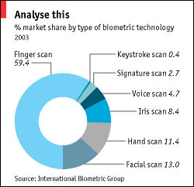
BIO-METRIC IDENTITY
Biometric Identifications Systems consist of a reader or scanning device, software that converts the scanned information into digital form, and, wherever the data is to be analyzed, a database that stores the biometric data for comparison with entered biometric data.
Emerging biometrical methods of identification include fingerprints, retinal and iris scans, hand geometry, facial feature recognition, ear shape, body odour, brain fingerprinting, signature dynamics, voice verification, and computer keystroke dynamics
Many banks started introducing this identity method in ATMs

Slide 16
Product management and financial services – Old and new
Confined marketplace
Unlimited market space
Competition between banks
Competition from brands
Limited product line
Extensive product breadth
One-size-fits-all product
Customization and innovation
Branch-focused
e-Enabled, multi-channel players
Focus on business growth
Focus on revenue growth as well as cost-reduction
Revenues through margin
Revenue generated through fees and value-added services

Slide 17
Outsourcing in Indian Banking
Globally, the banking and financial services sector has been at the forefront of the outsourcing movement. Third party service providers have also built greater processing and analytical capabilities and are able to handle more complex functions like financial modeling and equity research.
In contrast with global evolution of outsourcing, the Indian banking industry has been slower to outsource.
The Indian banking Industry is highly fragmented. There are banks ranging from small co-operative banks (presence limited to a few branches in a city) to large nationalized commercial banks like SBI with over 10,000 branches (one of the largest banking network in the world).
The Indian banking Industry is dominated by PSBs with 70% market share. Further, there are different issues that concern the Indian banks when outsourcing.

Slide 18

THANK YOUALL

